Slide 1
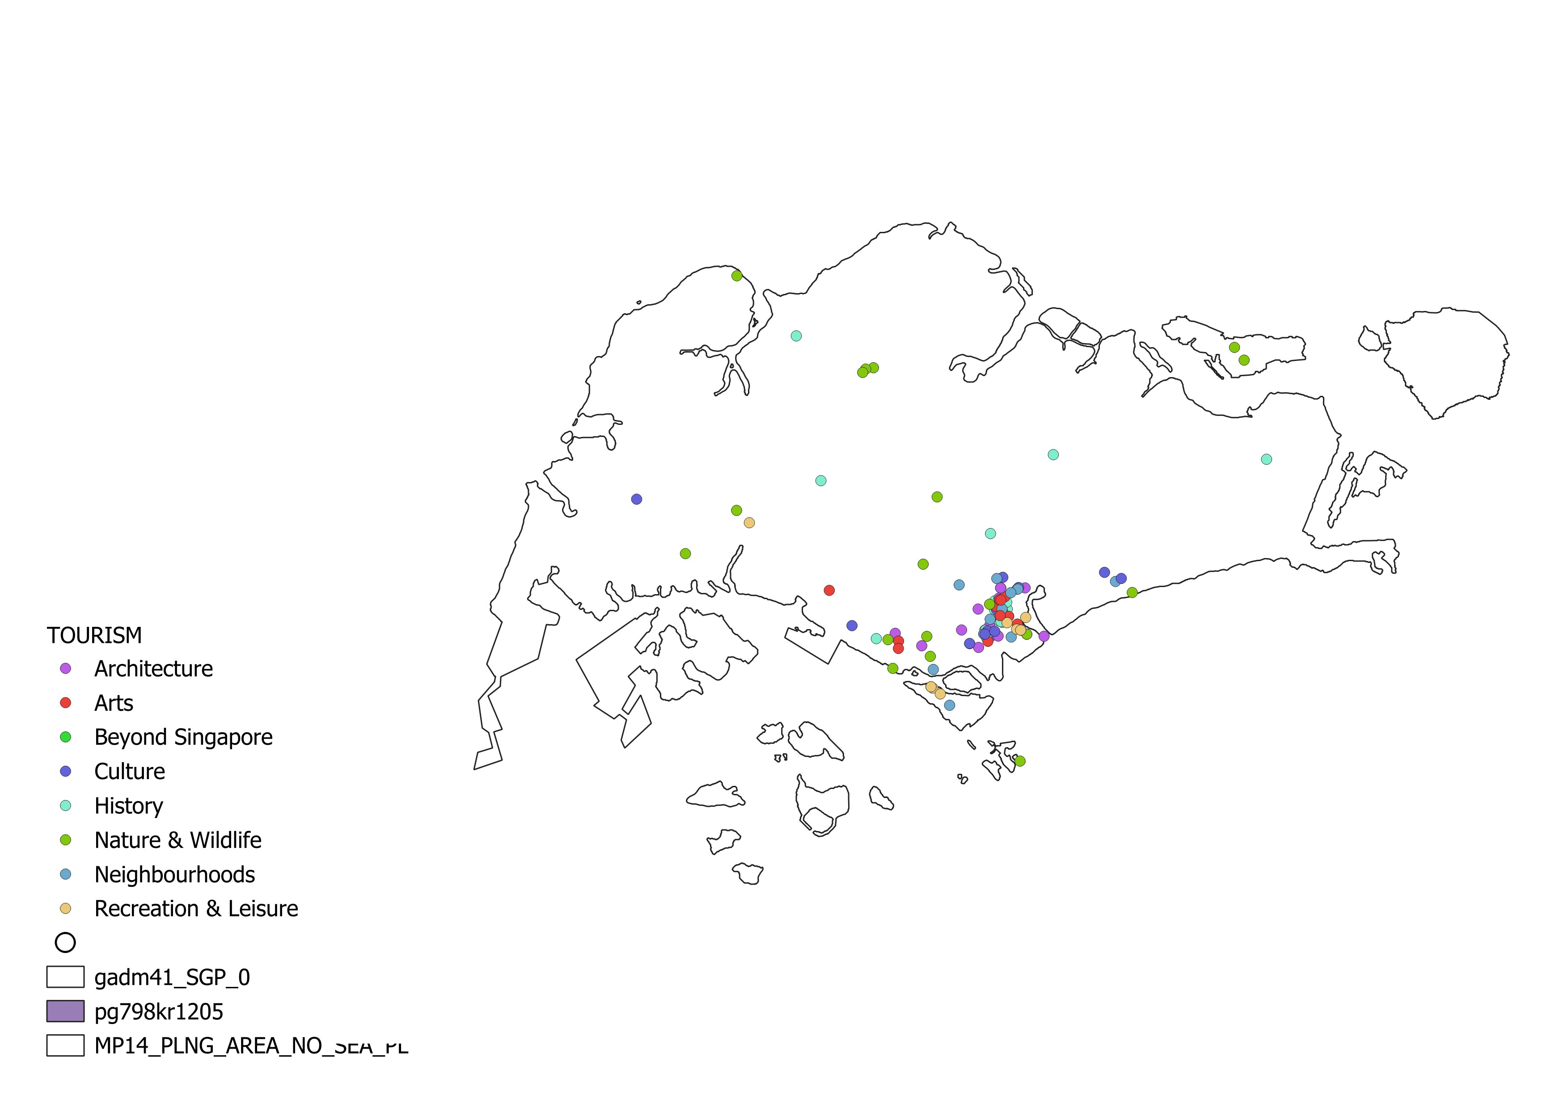
We have so much more than Gardens by the Bay and Marina Bay Sands to See & Do
Boundary Source:
- GADM
Tourism data Source:
- data.gov.sg

Slide 2
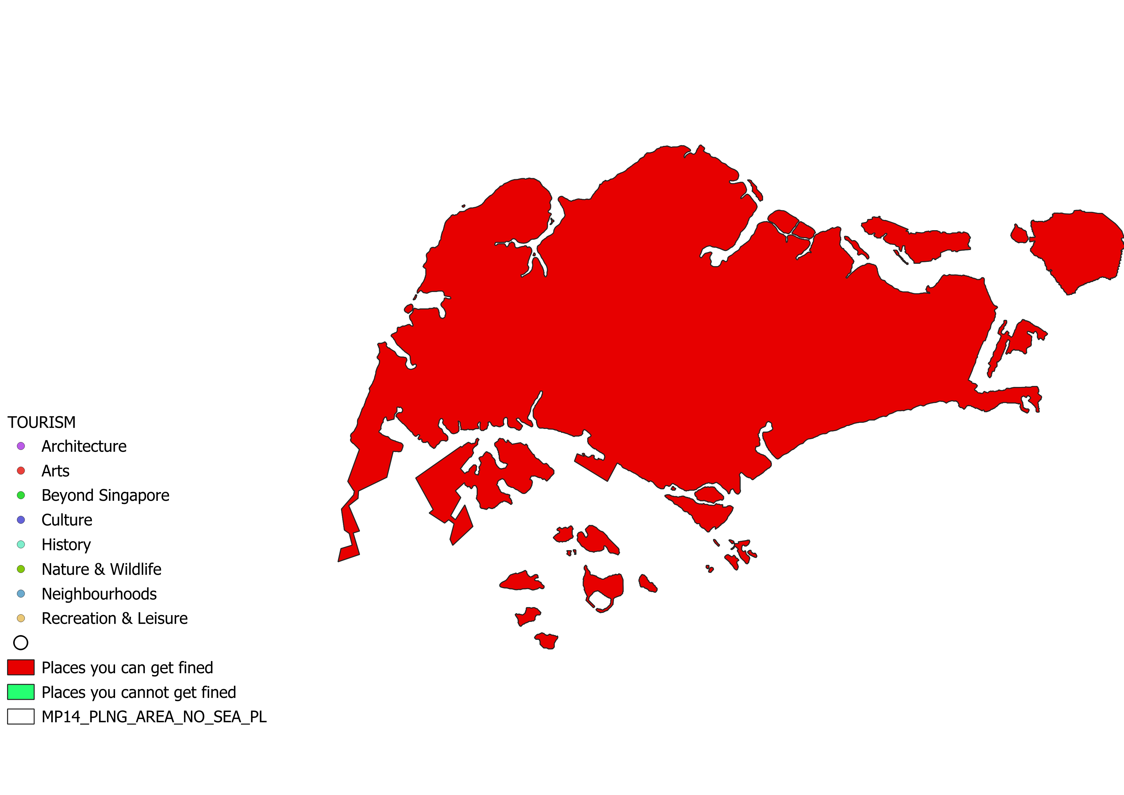
You won’t get fined for having chewing gum but maybe for a lack of common sense (e.g. littering, Vandalism)
Boundary Source:
- GADM

Slide 3
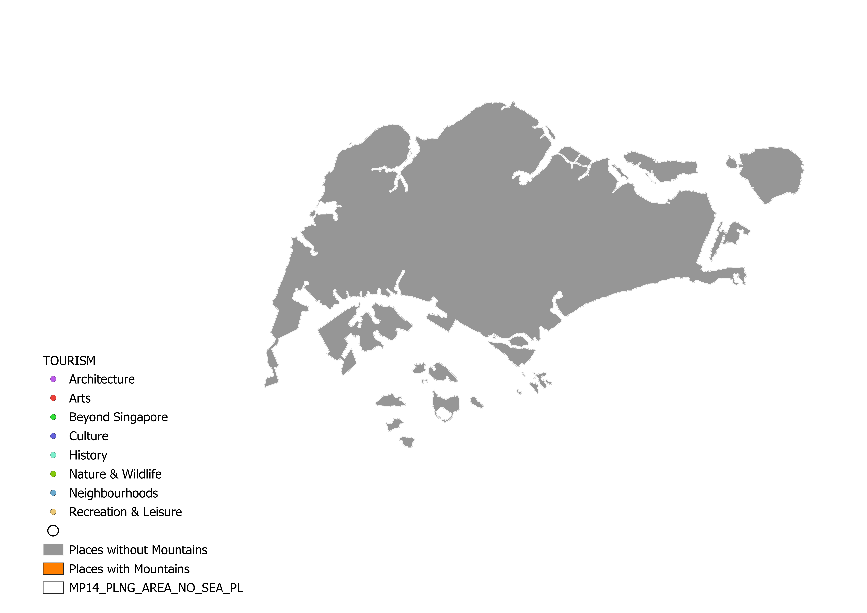
You love hiking? Does Singapore have mountains? 👉👈 We have bukit timah at ~164m.
Boundary Source:
- GADM

Slide 4
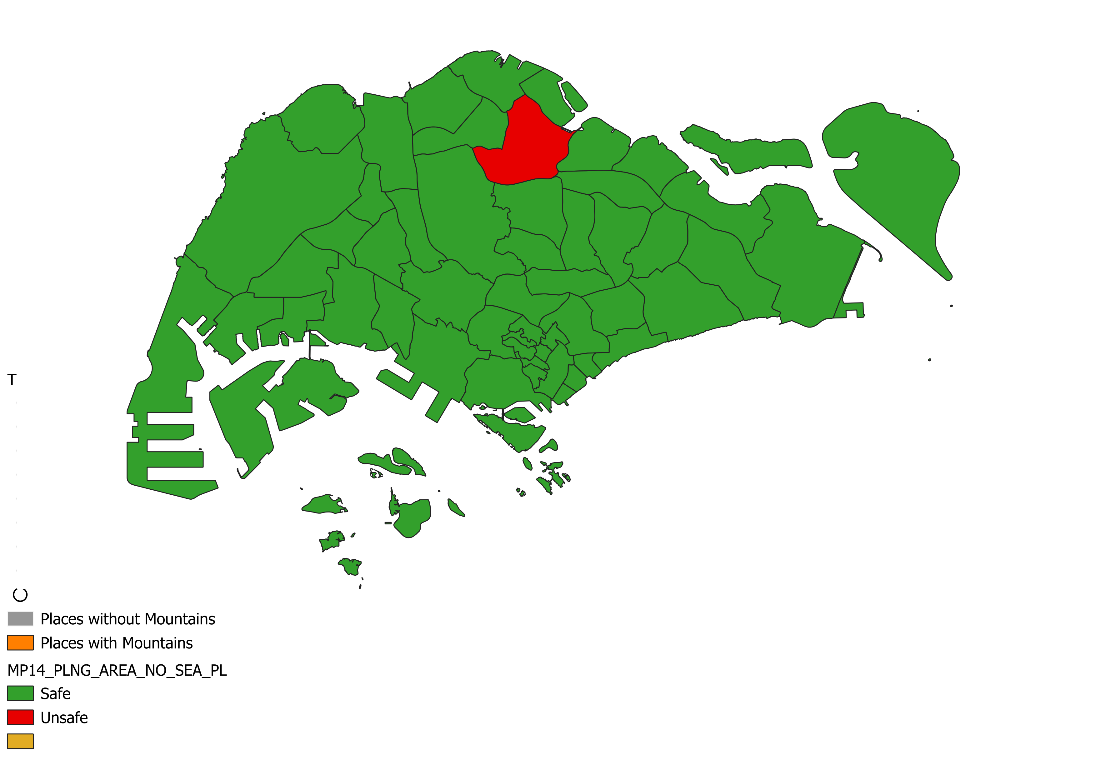
I heard Singapore is very safe 😅 Yes it is quite safe
Boundary Source:
- data.gov.sg

Slide 5
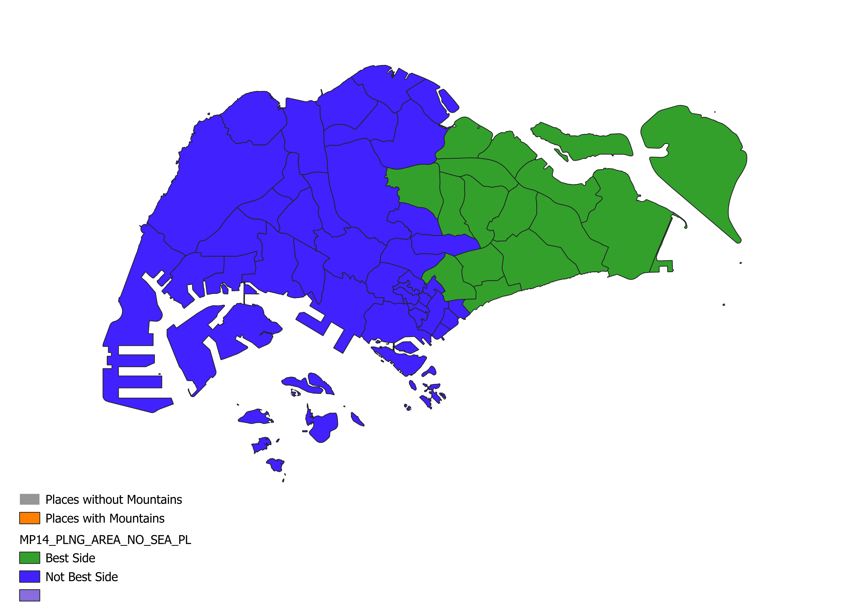
#eastsidebestside
Boundary Source:
- data.gov.sg

